Slide 1
Getting Candid:
Practical Guidance for Framing the Conversation Around Youth Substance Use Prevention
Notes:
Trainer Notes
Welcome
Tailor any audience details
Tailor logistics, agenda
With funding from the Centers for Disease Control and Prevention (CDC), the National Council for Mental Wellbeing is currently leading an initiative to assess the effects of the pandemic on substance use risks and drivers, specifically cannabis, alcohol and opioids, among youth aged 12-18 to equip youth-serving providers and organizations with the tools and resources necessary to support effective prevention messaging.
Through need assessments of 1,200 youth and more than 700 youth-serving providers, a literature review/environmental scan, focus groups and key informant discussions, the initiative gathered information and data informed a messaging guide that can be used by mental health and substance use treatment organizations, primary care, and other youth-serving providers to effectively engage young people in conversations to prevent substance use.
Today’s presentation will highlight the Communication Pathway from the message guide. It’s important to note that the messages within this pathway are tested and specific to substance use, but the steps within the pathway could be applied to other health communications.

Slide 2

Logistics for Our Virtual Space
Use the Chat to share ideas and ask questions.
Please let us know in the chat your name, title & location!
Handout attached in the chat box.
If you have any technical issues, please message Amanda Stark
Notes:
REMINDER: This webinar is not eligible for CEUs

Slide 3
Our Vision:
To make mental wellbeing,
including recovery from substance use challenges, a reality for everyone.
https://thenationalcouncil.org
Notes:
We are a membership organization founded in 1969, driving policy & social change on behalf of more than 3000 MH and SU tx orgs.
Mental wellbeing = thriving regardless of a MH or SU challenge.

Slide 4
Learning Objectives
1.
Learn how to frame conversations and deliver substance use prevention messages to youth.
2.
Understand the role of building rapport and trust with youth when delivering messages and discussing health-related behaviors.
3.
Gain implementation strategies for putting the message guide and toolkit into practice.
Notes:
TRAINER NOTES
Today’s training will highlight the Communication Pathway from the message guide. It’s important to note that the messages within this pathway are tested and specific to substance use, but the steps within the pathway could be applied to other health communications.
Welcome, context – (15)
Ntl assessments, Provider role (w/ provider video) – (15)
Establish Trust (5)
Comms Pathway, interactive chat activities (w/pathway video) – (25)
Toolkit resources (w/TikTok video) – (15)
Q&A (10)

Slide 5


It is our collective obligation to create environments
that keep the heat down for adolescents.
https://www.frameworksinstitute.org/
Notes:
Trainer Notes
Adolescence is like a simmering pot of water.
Click: And there are many factors that can raise the heat or keep it simmering at a healthy rate. How safe do they feel in their neighborhood? Is their family experiencing financial challenges? School or health concerns? These things can raise the heat – add substance use on top of them and the pot could boil over.
Click: All of us play a role in keeping the pot from boiling over by recognizing ways to adjust the temperature to keep the pot from boiling over. Supportive environments for managing mental health challenges. Systems where equitable policies, programs, or funding can help ensure young people have what they need to thrive.
Remediable – recognized, treated, reduced, resolved, recovered
MH: https://www.frameworksinstitute.org/wp-content/uploads/2020/05/annotated_before_and_after_ford_toolkit.pdf

Slide 6
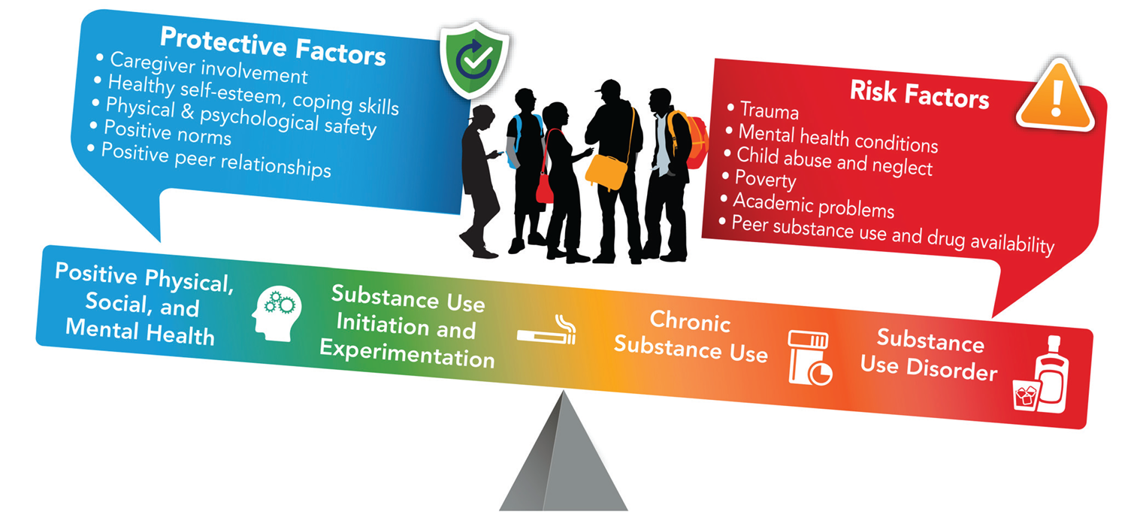
https://sbirt.webs.com/Hilton_Foundation_Youth_Substance_Use_Prevention_Infographic.pdf
Notes:
Trainer Notes
How to tip the scales toward protection… keep the pot from boiling over?
Having conversations contributes to wellbeing. A relationship with a trusted adult is a protective factor.
Protective factors - things that help a person deal more effectively with stressful events and reduce the impact of a risk factor.
Risk factors – things that increase a person’s likelihood of using substances and experiencing other harms associated with use.
Risk and protective factors may be biological, psychological, environmental, cultural or genetic
Remediable – recognized, treated, reduced, resolved, recovered

Slide 7
Supporting adolescents
leads to healthier and more connected communities
We need to reframe adolescence from eye roll to opportunity.
Nat Kendal-Taylor, CEO of The Frameworks Institute
Notes:
Trainer Notes
We may make assumptions of young people = risk, danger, surrounded by threats, unable to make good decisions can lead us to coddle, dictate and take over the decision-making process for them. This string of assumptions can hold young people back.

Slide 8




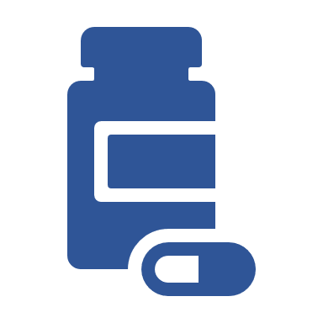
About Getting Candid
Purpose
Approach
Result
To assess effects of the pandemic on substance use risks and drivers
National online assessments, focus groups, youth ambassadors & expert advisors
Message guide & toolkit for youth-serving providers to support youth ages 12-18
This project is supported by the Centers for Disease Control and Prevention (CDC) of the U.S. Department of Health and Human Services (HHS) as part of a financial assistance award totaling $2,000,000 with 100% funded by CDC/HHS. The contents are those of the author(s) and do not necessarily represent the official views of, nor an endorsement, by CDC/HHS or the U.S. Government.
Notes:
Trainer Notes
With funding from the CDC we set out to learn about the effects of the COVID pandemic with regard to risks & drivers of youth SU.
Will is going to share some highlights from our national assessments and we worked alongside several experts in the field and YA.
Message guide and toolkit for youth-serving providers to support effective prevention with youth ages 12-18

Slide 9
National Assessment Data
Four online surveys = 2,979 youth
Weighted by age, gender identity, race/ethnicity, region of the country and area community type (e.g., rural, urban)
One online survey = 761 youth-serving providers
Representing community behavioral health, education, healthcare, government and other community organizations
From Lake Research Partners, commissioned by
the National Council for Mental Wellbeing, 2021-2022
https://www.thenationalcouncil.org/resources/cdc-key-findings/
Notes:
Trainer Notes
This slide provides a helpful overview of the iterative process our project team engaged in to create our Message Guide and Toolkit including surveys and discussion groups. ​​
4 assessments with 600-900 youth each time. ​​
Samples weighted by age, gender identity, race/ethnicity, region of the country and area (big city, smaller city, outside of a city/suburb, rural)​​
1 assessment with 761 providers ​​
Representing CBHOs, education, healthcare, govt and other community orgs​​
Surveys were followed up by message testing to small groups of youth

Slide 10
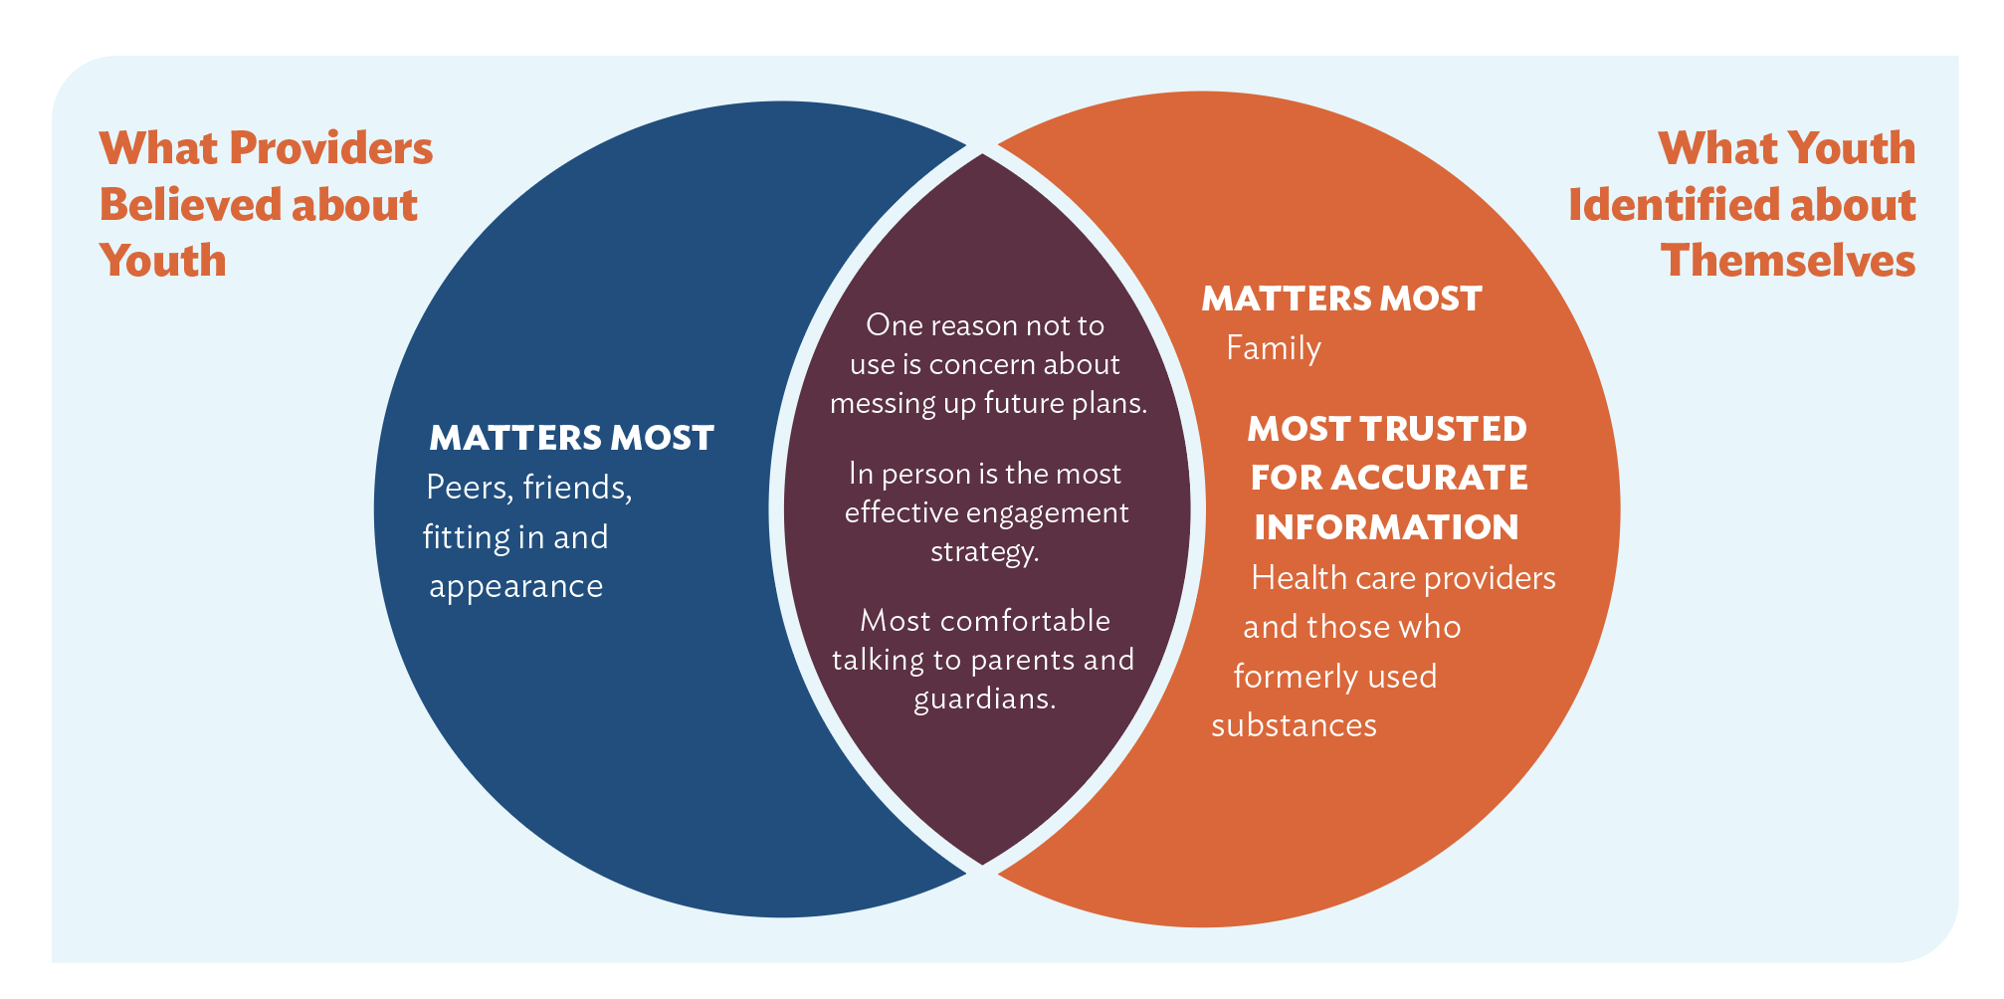
Key Finding: Youth vs. Provider Perceptions
From Lake Research Partners, commissioned by
the National Council for Mental Wellbeing, 2021-2022
https://www.thenationalcouncil.org/resources/cdc-key-findings/
Notes:
​
Trainer Notes
Following our surveys and discussion groups we created the following venn diagram to help visualize the disconnect between provider perceptions of youth (on the left) and youth actual perceptions (right)​​
Matters Most-Provider​​
Matters Most-Youth​​
Areas of Alignment​​
Youth Trusted Messengers ​

Slide 11
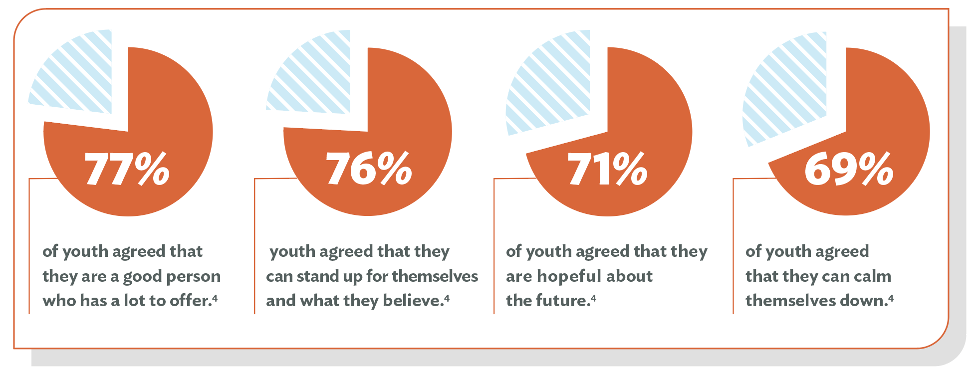
Key Finding: Resiliency and Optimism
From Lake Research Partners, commissioned by
the National Council for Mental Wellbeing, 2021-2022
https://www.thenationalcouncil.org/resources/cdc-key-findings/
Notes:
Trainer Notes
Even though youth were experiencing elevated levels of stress, a majority of those surveyed agreed with these positive statements. Providers can use this information to lean into a strengths-based perspective when navigating conversations around substance use and mental health.

Slide 12
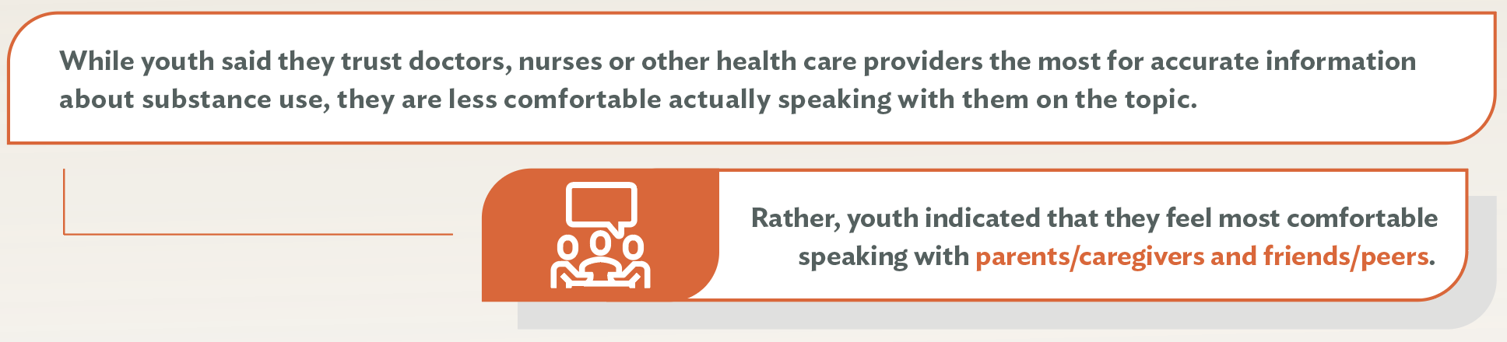
Key Finding: Trust vs. Comfort
From Lake Research Partners, commissioned by
the National Council for Mental Wellbeing, 2021-2022
https://www.thenationalcouncil.org/resources/cdc-key-findings/
Notes:
Trainer Notes
An important aspect in messaging is teasing out the different between trust and comfort when it comes to talking with adults about SU. This is from June 2022​​
​​
Trust-expert knowledge, comfort-openness and safety to having that conversation​​
Read trust and then comfort slides

Slide 13
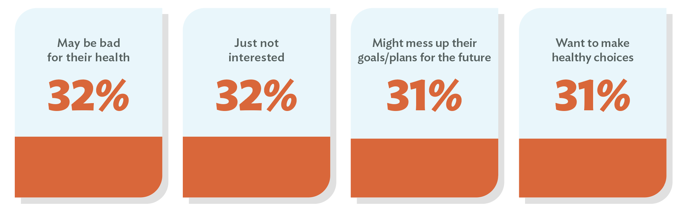
Key Finding: Top 4 Reasons Not To Use
From Lake Research Partners, commissioned by
the National Council for Mental Wellbeing, 2021-2022
https://www.thenationalcouncil.org/resources/cdc-key-findings/
Notes:
Trainer notes​
When we understand why youth might choose not to use we can use substances, we can develop messages that resonate with what matters to them.​
​

Slide 14

Your Role as a Youth-serving Provider
Create a safe space to normalize conversations about substance use and its connection to health, school, finances and relationships.
Maximize regular touch points and established relationships to reinforce prevention messages and encourage healthy peer relationships.
Identify potential risk and protective factors.
Notes:
Trainer Notes
Moving from the findings to you - these findings highlight the collective obligation for all of us in our own ways to find opportunities to support youth​
​
Go through points​
​
As we move from the online assessment results to your role as providers, let’s hear directly from the young person

Slide 15
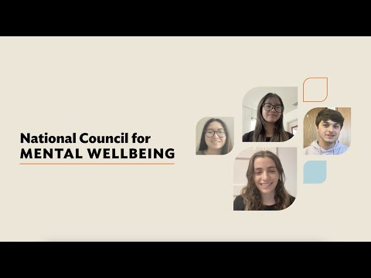
Video: What Youth Want You to Know
https://youtu.be/kyD4DCDv_wU
Notes:
Trainer notes
This three-minute video highlights insights from youth about talking to providers and other adults.

Slide 16


Inside the
Getting Candid Message Guide
https://www.thenationalcouncil.org/getting-candid
Notes:
Trainer Notes
With this in mind (youth informing how we work) we are going to go inside the GC Message Guide that was developed through the online assessments and discussion groups with the goal of equipping youth-serving providers with substance use prevention messaging with. We developed this through getting grounded in the attitudes and beliefs of young people to learn effective substance use prevention communication strategies with youth. ​

Slide 17
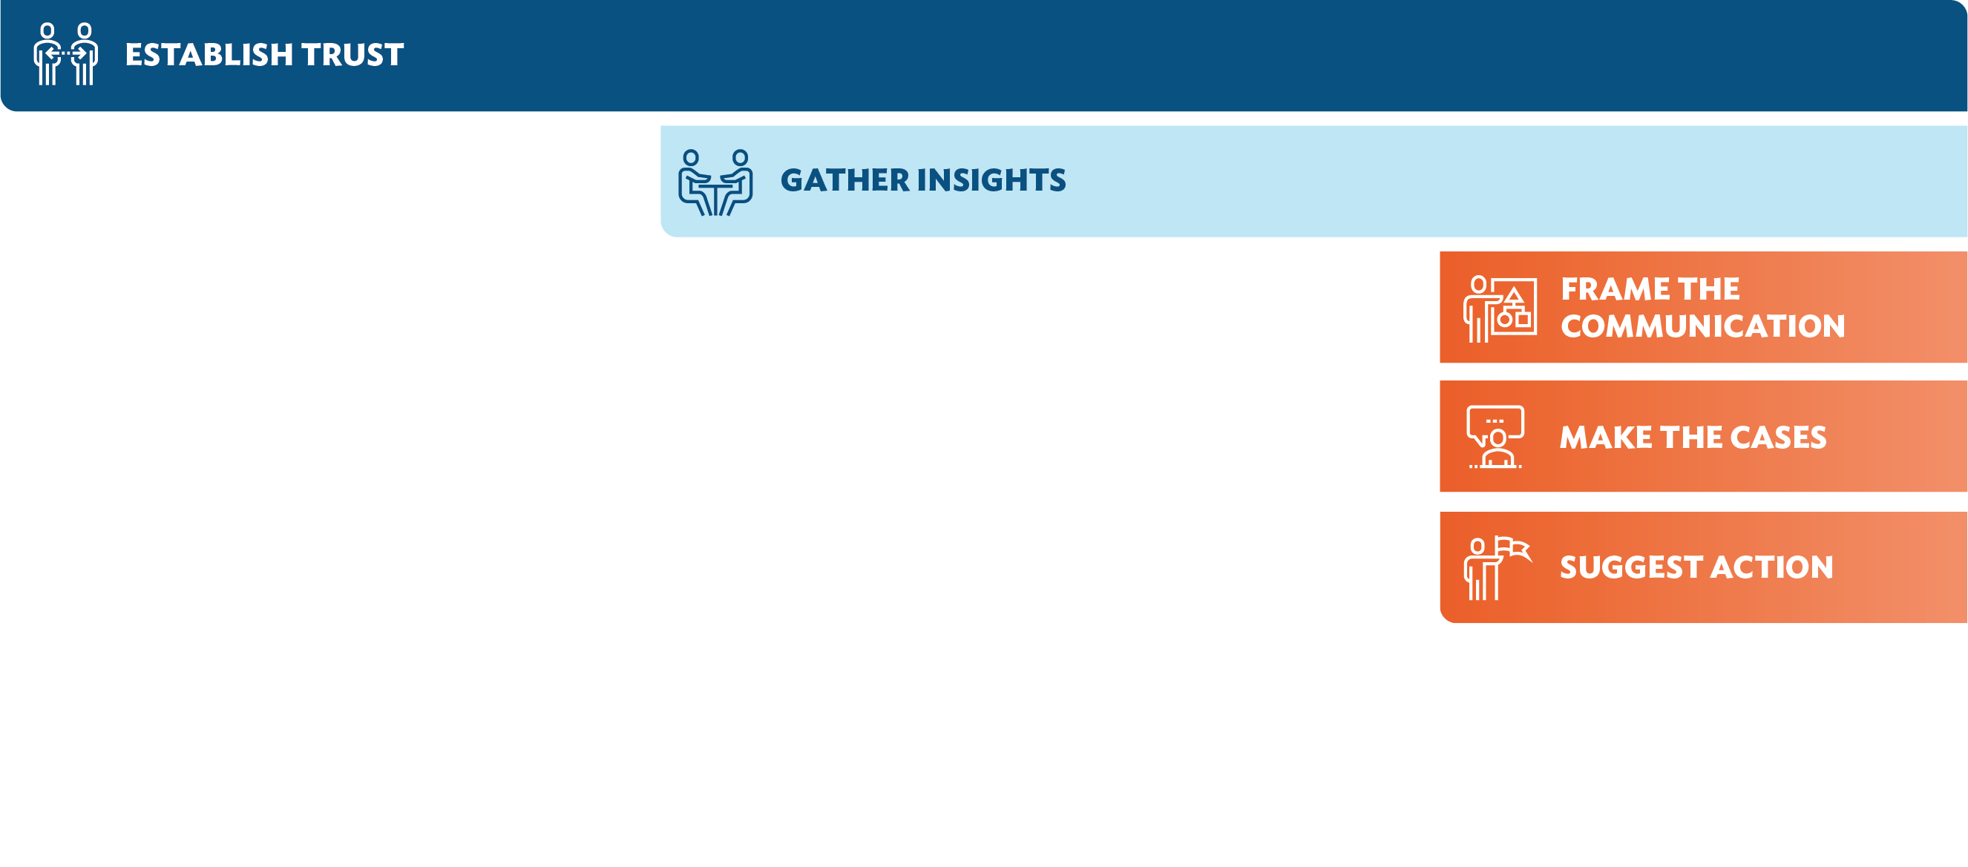
Communication Pathway
Build rapport and establish trust.
Seek guidance and input from youth on what matters to them.
Frame the Communication
Make the case
Suggest action
Choose the frame for communication based on insights from youth.
Select evidence to provide compelling reasons not to use drugs or alcohol.
Select one or more actions to suggest.
Notes:
Trainer Notes
Key feature of Message Guide is the Comms Pathway. This pathway is intended to share a simple process for communication that can be tailored to any circumstance.​
-The pathway begins with establishing trust. Communication is most effective from trusted sources, so it is critical to establish trust before messaging as well as sustaining throughout. ​
-Gathering insights from the youth- We want to find out from youth themselves what matters the most. ​
-From there we frame the communication around what we learn matters most to the young person, make the case around not using substances or cutting back, and then ideally some type of next step. Pam will touch more on theses steps. Ultimately it is a cycle.

Slide 18
Establish Trust
Build rapport and establish trust.
Ask permission before sharing information with them.
Create a safe space.
Be authentic.
Approach the conversation informally.
Do more listening than talking.
Be transparent and trustworthy.
Pay attention to body language.
Notes:
Trainer Notes
The pathway begins with establishing trust. We know from counseling and therapy research that the quality of relationship that we have with the client is one of if not the most impactful factors of positive change. ​
​
Ask Permission: Don't assume. (Would you be open to hearing about…?) ​
Create a safe space: Is the physical or virtual space welcoming and comfortable? Safe and private? Is signage, supportive and inclusive of diverse cultures, languages and communities? ​
Be authentic: Youth feedback included wanting adults to be authentic and real. Treat them as someone with valuable experiences and contributions.​
Approach conversation informally: Youth want an informal conversation, talk about what matters to the youth – not scripted.​
Transparency to build trust and protect confidentiality. Remind about legal and professional obligations. ​
Body language – reduce power dynamics by getting on the same level.

Slide 19

Youth Ambassador Tips for Building Trust & Rapport
Do not assume you understand experiences and/or identities of people from different cultures and/or religions.
Ask youth to briefly explain their cultural and/or religious background, to include the meanings of traditions, some of the holidays and/or celebrations, and important people within the group.
Ask youth how they would like their sexual orientation, gender identity, cultural and/or religious background recognized and respected when receiving care and services.
Ask youth about any doubts or concerns and try to uncover any misconceptions they may have about seeking services. If possible, politely and respectfully help resolve any doubts and correct any misconceptions.
Notes:
Trainer Notes
Here are some tips straight from one our youth ambassadors…

Slide 20

Gather Insights
Seek guidance and input from youth on what matters to them.
Ask open ended questions such as…
What matters most to you in your life and why?
What are you looking forward to most in the coming year (or after you graduate, or beyond) and why?
When you’re faced with making a tough choice or decision, what do you consider or think about most?
Notes:
Trainer Notes
The pathway continues with gathering insights from the youth. No one prevention message will be appropriate for all youth, so it's important to elicit insights that help inform how you frame the conversation for the specific youth you’re talking to.
Ask open-ended questions with empathic curiosity to help inform which frame to choose (the next step in the pathway).
What you learn can become an opportunity to connect what matters to them with substance use prevention.
Return to this part of the pathway often, to continue gathering additional insights and give the youth a voice in collaborating.

Slide 21


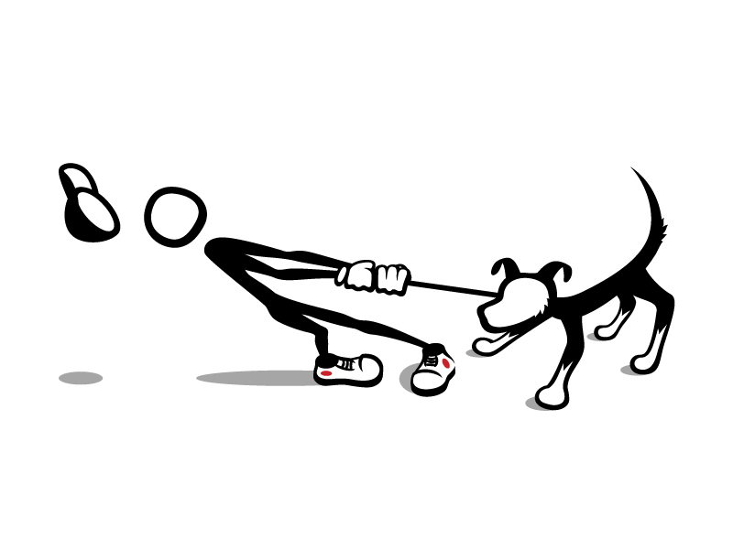
Three Tips
Declutter
Stay Curious
  Pause the Fix
Notes:
Trainer Notes
Am I able to clear my mind, be present? Am I calm, emotionally regulated enough to create psychological safety? Being present is prob the hardest thing to do.
Can I stay curious to give them a voice? Adol developmental stage involves self-exploration, finding their identity in the world around them.
Power struggles come from the reflex of wanting to fix or be right. Not about “winning” if relationship is what truly matters. The conversation should feel like dancing, not wrestling. Pushing/pulling too hard increases resistance.

Slide 22
Gathering Insights with Alex, age 15
My best friend at school has been smoking weed - a lot. He’s stressed all the time because his parents are getting divorced. He says he is angry and no one understands. I’m not going to ditch him but I don’t want either of us to get into trouble from the weed.
Notes:
Trainer Notes
How would you approach this, to gather insights?
Declutter – Curious – Pause the Fix – Open Ended Q

Slide 23
Communication Pathway
Frame the Communication
Make the case
Suggest action
Notes:
Trainer Notes
If we really commit to building trust, staying curious and listening to young people then we have a foundation for the other times that could be more challenging, but hopefully easier with the foundation of trust!
80% relationship focused, no agenda, less talking
20% problem solving, still collaborative

Slide 24
“What Matters” Becomes the Framework
What Matters…? |  | Message Frame
Plans for the coming year, for entering high school, college or for the future in general |  | The future
Physical or mental health |  | Risk of addiction
Relationships (e.g., parents/guardians, friends, teachers, coaches, mentors) |  | Relationships
Activities in or out of school (e.g., music, sports, volunteering) |  | Activities
Being respected for autonomy and being able to make one’s own choices |  | Self-affirmation
Notes:
Trainer Notes
Tie the subject of substance use to what matters most to youth, increasing receptivity to the conversation, setting the stage for authentic interaction.
May be more than one thing that matters, may be more than one frame that resonates. Weave them through conversation, paying attention to where the youth responds, return to them periodically to shape and connect the conversation.
The Future and Risk of Addiction resonated across the widest range of middle and high school youth. This is recommended when communicating broadly (e.g., via social media or advertising) or if there is limited time, though it is important to gather insights for framing when possible.
The Future message: 85% of middle schoolers and 82% of high schoolers identified the future as one of the top reasons not to use.
Risk of Addiction message: 77% of youth identify risk of addiction as a convincing message they might hear from a provider.

Slide 25
Frame the Communication
Frame the Communication
Most effective messages tested with youth:
The Future: Don’t let drug and alcohol use change or control your plans for the future.
Risk of Addiction: Drug and alcohol use changes parts of your brain that impact how you think and act. The more you use, the harder it can be to stop, even if you want to.
Relationships: There are people in your life who matter to you. (For middle school) And you try hard not to let them down. (For high school) And you try hard to make them proud.
Activities: Participating in sports, music, hobbies or other activities can help you build friendships, stay in shape, get into and receive scholarships for college and have fun.
Self-affirmation​: You respect yourself and want to make decisions that are best for you. Trust yourself and your choice not to use drugs or alcohol.
Notes:
Trainer Notes
Message testing in 2021 with youth found these were most effective. We encourage you to tailor the framing as needed!
The Future and Risk of Addiction resonated across the widest range of middle and high school youth. This is recommended when communicating broadly (e.g., via social media or advertising) or if there is limited time, though it is important to gather insights for framing when possible.
The Future message: 85% of middle schoolers and 82% of high schoolers identified the future as one of the top reasons not to use.
Risk of Addiction message: 77% of youth identify risk of addiction as a convincing message they might hear from a provider.
Relationships messages: Note the difference in the Relationships message by age. While middle school youth care very much about not disappointing the people in their lives, high school youth respond better to the idea of making the people they care about proud.

Slide 26
Make the Case
Frame the Communication
Make the case
Frame the Communication
Examples of statements considered most convincing by youth:
People in recovery from addiction often say one of the things they regret most about their addiction is the trust they lost from people who care about them.
Vape companies regularly change up their chemical formulas to get around regulations and safety testing of their products.
It only takes a pinprick-sized amount of fentanyl to be a deadly dose. And it’s sometimes hidden in fake prescription pills.
Delta-8 THC is not regulated, so you don’t really know what is in it. Some people ended up having a medical emergency because the concentration was too high or they didn’t realize delta-8 THC was psychoactive until it was too late.
Notes:
Trainer Notes
This is a sample of some statements youth found convincing. Many additional messages can be found at: https://www.thenationalcouncil.org/wp-content/uploads/2021/11/A-Communication-Pathway-for-Providers-2022-10-21.pdf
Young people indicated wanting facts without judgement and wanting acknowledgement of harm reduction.
Youth noted that asking permission before making the case was an important way to build trust.

Slide 27





Suggest Action
Frame the Communication
Make the case
Suggest action
Frame the Communication
Actions identified by youth as those they would most likely take:
Explore new ways of dealing with stress, like music, reading, art, getting outdoors, talking with friends you trust or just being by yourself.*
Find someone you can talk to if you feel tempted or pressured to use alcohol, tobacco/nicotine, marijuana or other drugs.
Educate yourself about alcohol, tobacco/nicotine, marijuana and other drugs by visiting a website or information on social media from a factual source.
Talk to your friends. Encourage them not to use alcohol, tobacco/nicotine, marijuana or other drugs.*
Make your own personal commitment or pledge to avoid alcohol, tobacco/ nicotine, marijuana and other drugs.*
*Resonated particularly well with middle school youth.
Notes:
Trainer Notes
Ideally, end the conversation with a suggestion of a next step or action. Youth said these were the most compelling actions.
Note: The ones with asterisks (*) resonated particularly well with middle school youth.
Stress - Tie the suggested action to opportunities in the community or at the youth’s school (e.g., music program, nearby forest or park, art classes).
Commitment - Consider a physical or virtual pledge form that youth can sign.
Friends - Suggest ways youth might be able to broach the conversation with their friends.
Educate self - Refer to your website or another resource. There are sample communication resources in the Getting Candid toolkit.
Talk - Brainstorm with the youth about the adults they trust (e.g., teacher or counselor, minister, coach).

Slide 28
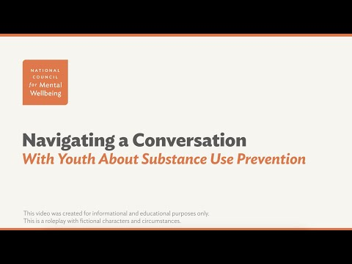
Video: Navigating a Conversation
https://www.youtube.com/watch?v=IOaK-VOcU3M
Notes:
Trainer Notes
https://www.youtube.com/watch?v=IOaK-VOcU3M

Slide 29
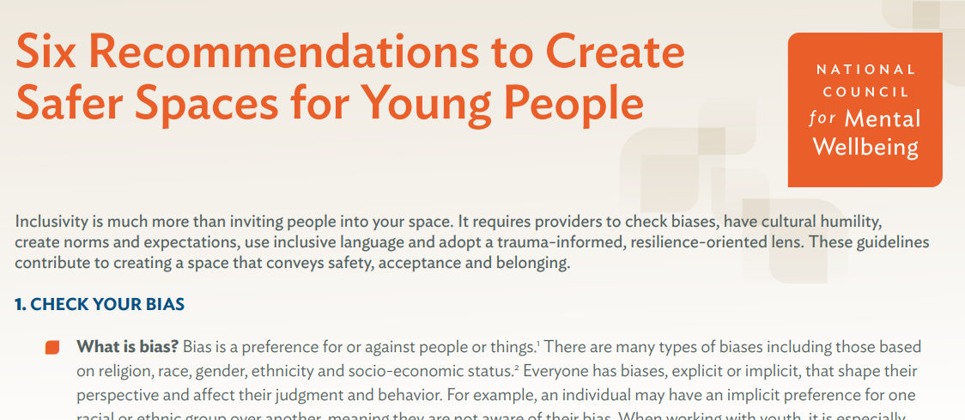
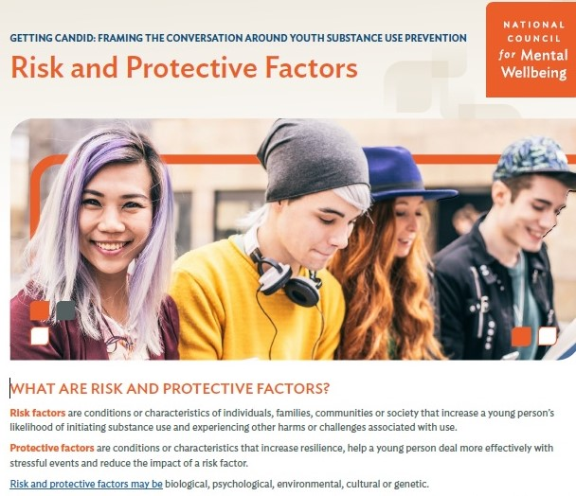
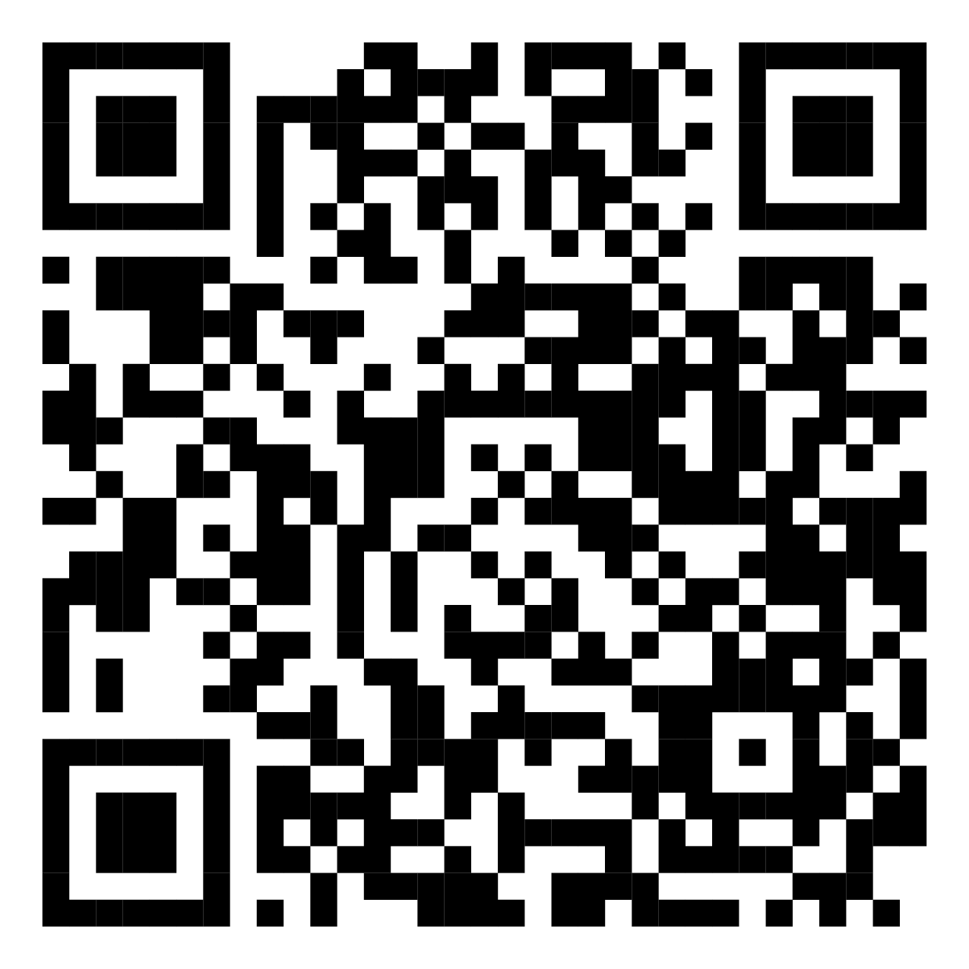
Getting Candid Toolkit
Over 140 resources
https://www.thenationalcouncil.org/program/getting-candid/resource-toolkit/
Notes:
Trainer Notes
Go through site live - There are more than 140 resources to choose from! All are free to use, though source acknowledgement is appreciated.

Slide 30
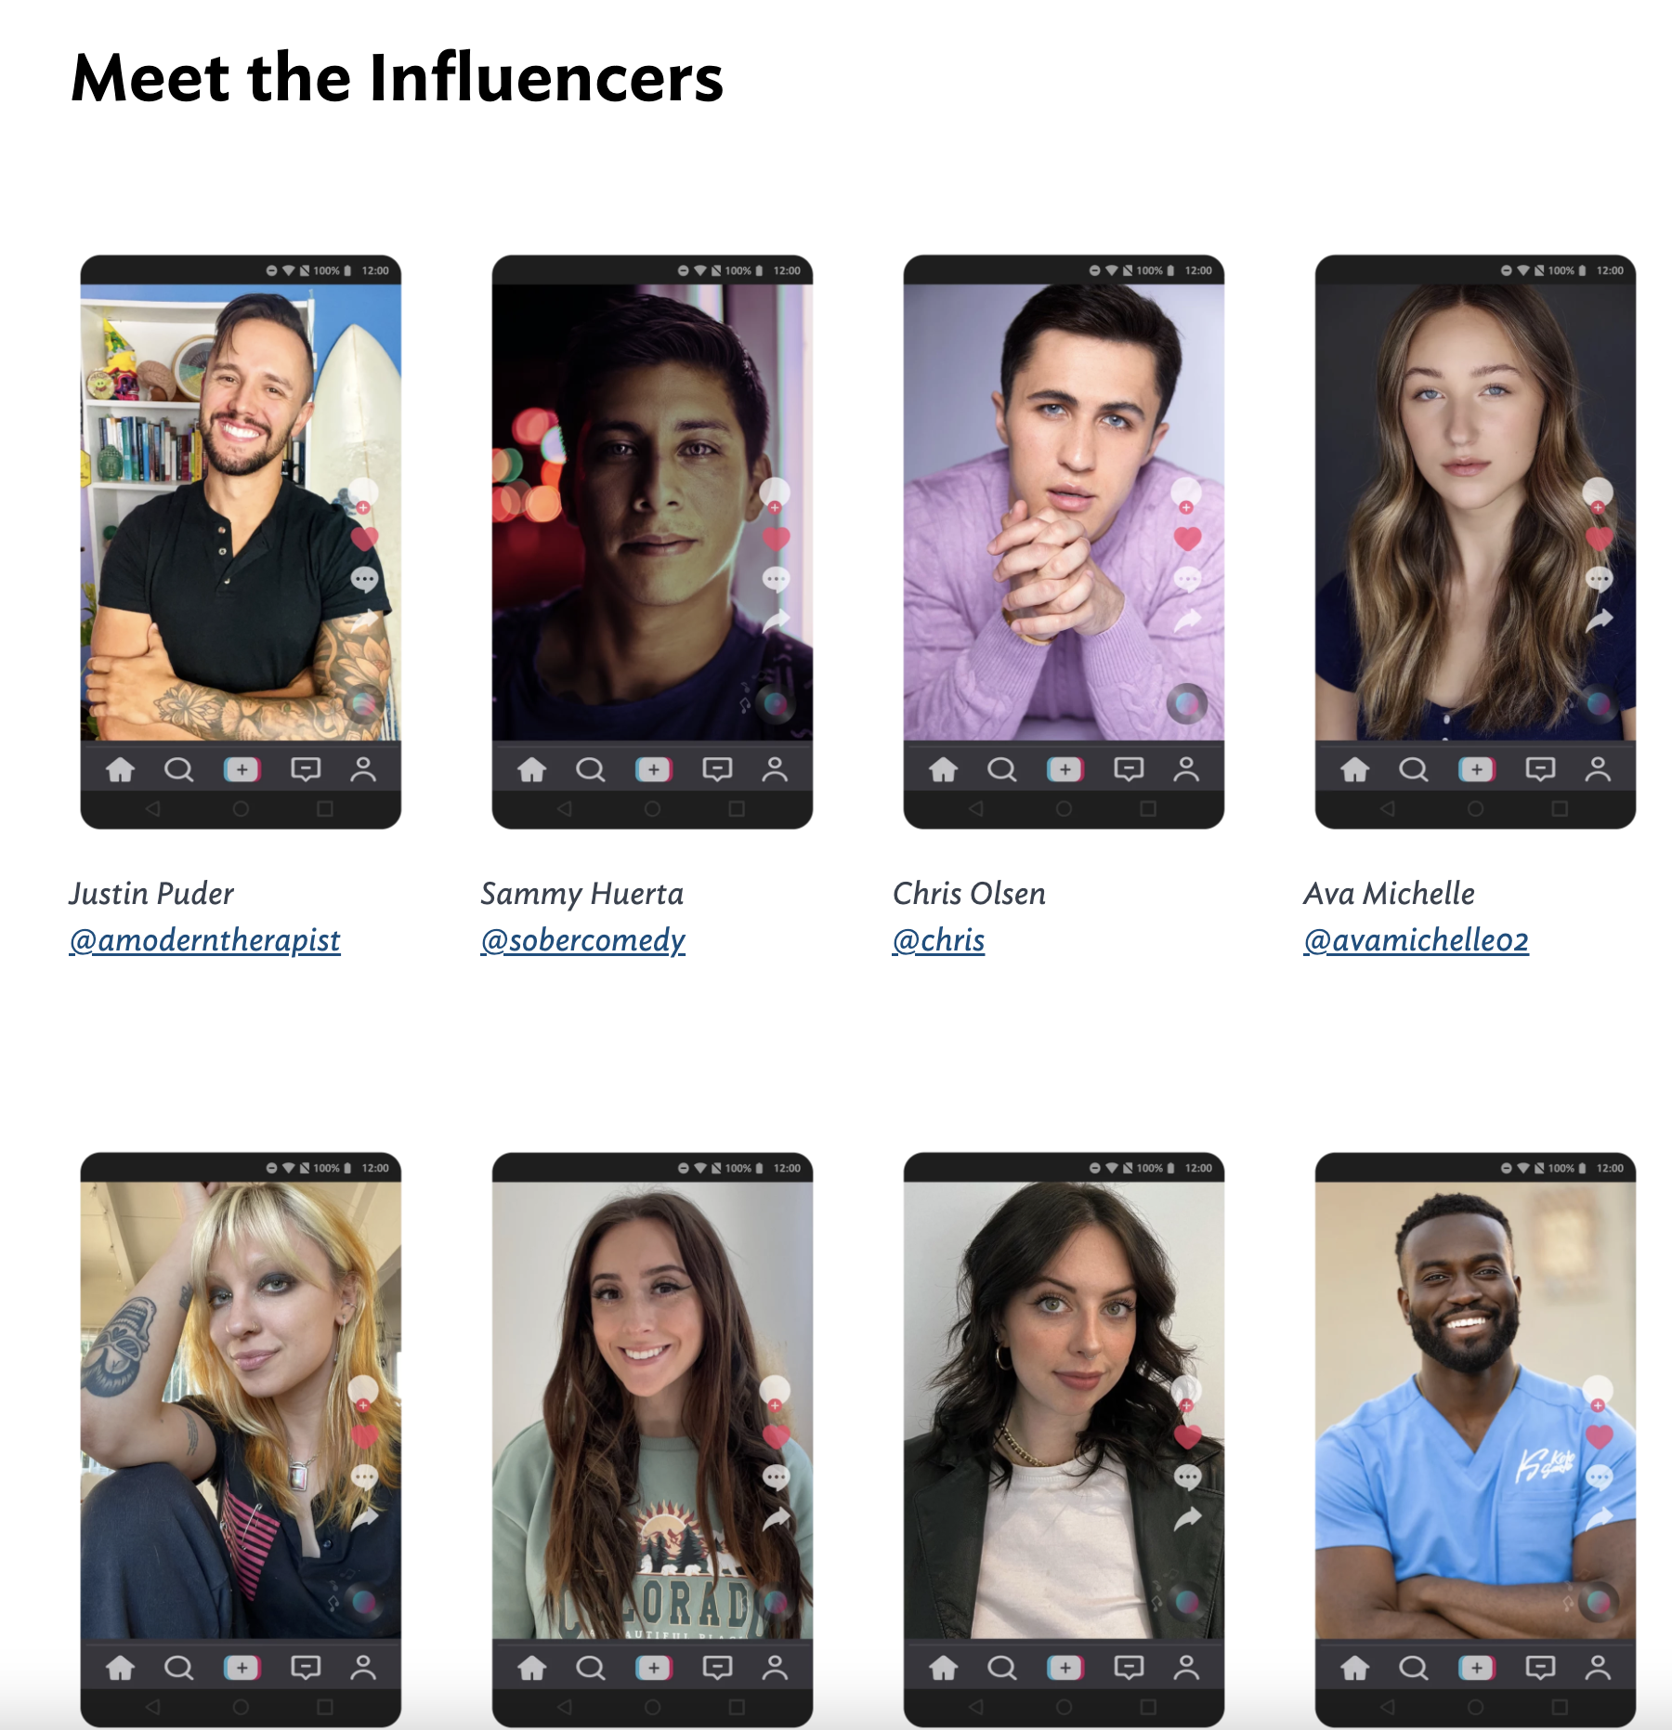
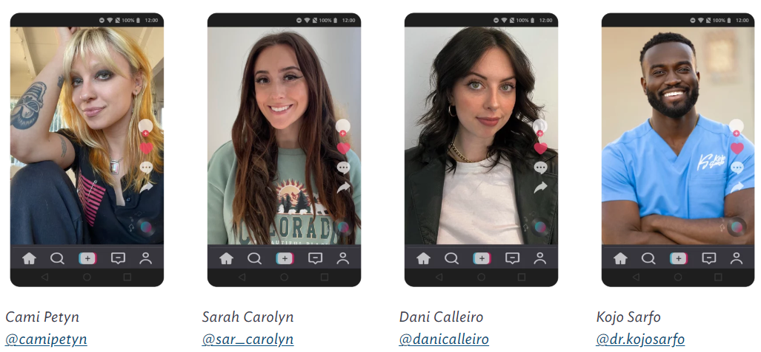
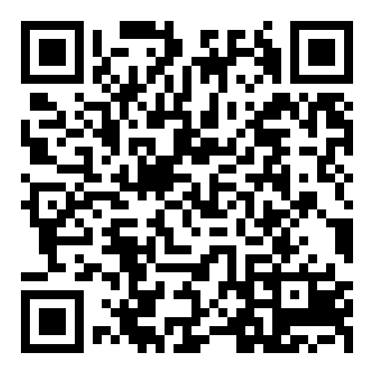
Youth-facing Content
Social media influencers
Youth-focused resources
Youth Ambassador blogs
Our TikTok Influencers
campaign launched in Feb!
https://www.thenationalcouncil.org/itsthelittlethings/
Notes:
Trainer Notes
The National Council also launched a TikTok influencer campaign to support youth and the channels that they use from a strengths-based perspective. They partnered with 8 influencers who you will see above to disseminate mental health and substance use messaging to youth. The campaign received millions of views! They also created a site specifically geared towards youth. (QR code to visit youth facing webpage)
QR code to visit youth facing webpage

Slide 31

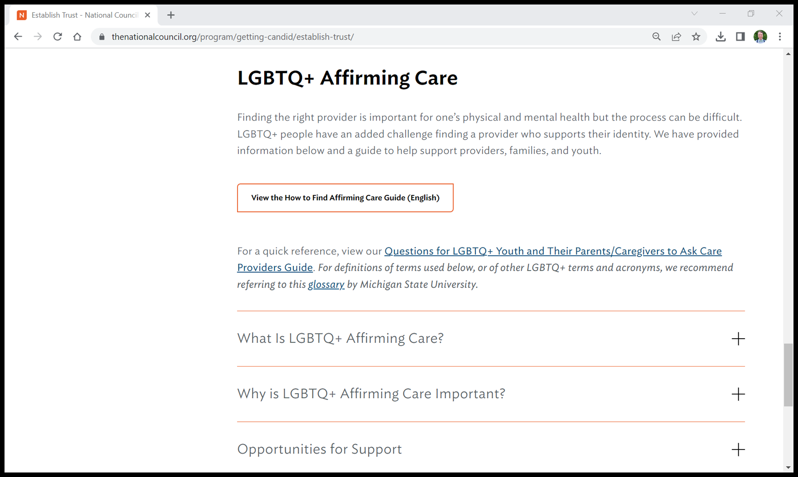
Content LGBTQ+ Affirming Care
https://www.thenationalcouncil.org/program/getting-candid/establish-trust/
Notes:
Trainer Notes
This past June, the Getting Candid team created an important and unique resource to help parents and caregivers of LGBTQ youth, and youth themselves in finding an affirming health care provider. This resource outlines what an affirming provider looks like, lists potential questions to ask providers, and guidance for locating affirming care providers.
We also created a guide that overviews LGBTQ+ Youth Risk Factors and how to help.

Slide 32
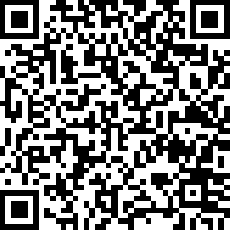
Additional Resource: Workshops
Interested in bringing a Getting Candid virtual workshop to your workplace or other group of youth-serving providers? Fill out our workshop request form linked below or reach out to us via email at GettingCandid@TheNationalCouncil.org.
https://www.surveymonkey.com/r/ttarequestform

Slide 33
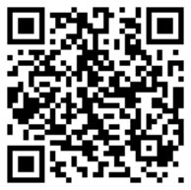
Questions?
Survey​
Please complete this brief survey to tell us how we did!​
​
https://www.surveymonkey.com/r/VZDB8QS​
Notes:
Trainer Notes
Thank you for your time today! If you have any questions…

